Slide 1
AlphaGo: The New Dominator of Go
Xu Li, Han Yu
School of Software

Slide 2
Header
Title
AlphaGo: The New Dominator of Go
General purpose
My purpose is to inform my audience about AlphaGo
Central idea
AlphaGo is a powerful Artificial Intelligence that will dominate Go.
Organizational patterns
Chronological order

Slide 3
What is AlphaGo

Slide 4
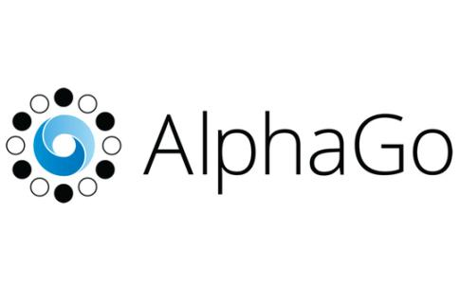
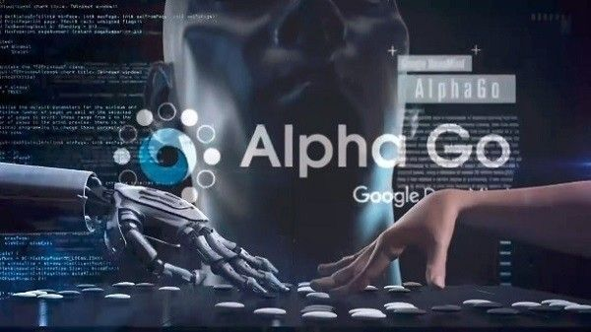
Resume
A narrow AI computer program developed by Alphabet Inc.'s Google DeepMind in London to play the board game Go.
The first Computer Go program to beat a human professional Go player
One of the Breakthrough of the Year runners-up on 22 December 2016 chosen by Science

Slide 5
Splendid Records
Time | Opponent | Score
2015.10 | Fan Hui (European Go Champion, 2-dan professional) | 5 : 0
2016.03 | Lee Sedol (one of the best players at Go, 9-dan professional) | 4 : 1
Late 2016 – early 2017 | 60 players including three victories over Go’s top ranked player(unofficial online matches) | 60 : 0
2017.05 | Ke Jie (the world No.1 ranked player,) | 3 : 0
After the match between AlphaGo and Ke Jie, AlphaGo will retire while DeepMind continues AI research in other areas instead of Go.

Slide 6
How does AlphaGo work

Slide 7
Prerequisite
Deep Learning
Neutral Network
Machine Learning

Slide 8
What is Machine Learning?
What is Program?
Program is a process. With a input X, it returns a correspond output Y.
Program
X
Y
What is Machine Learning?
Machine Learning is a kind of special program. With a series of input X, it returns a program.
X1
Machine Learning
Program
X2
…
Xn
Training Set
Notes:
Before talking about how alphago works, we first need to know what is machine learning. To answer this question, we might need to answer another first: what is program.
A program is a process. With a input X, it will return a correspond output Y. And for machine learning, it is a kind of special program. With a series of input X, it will return a program. And for the inputs, we have a special name for it, the training set.

Slide 9
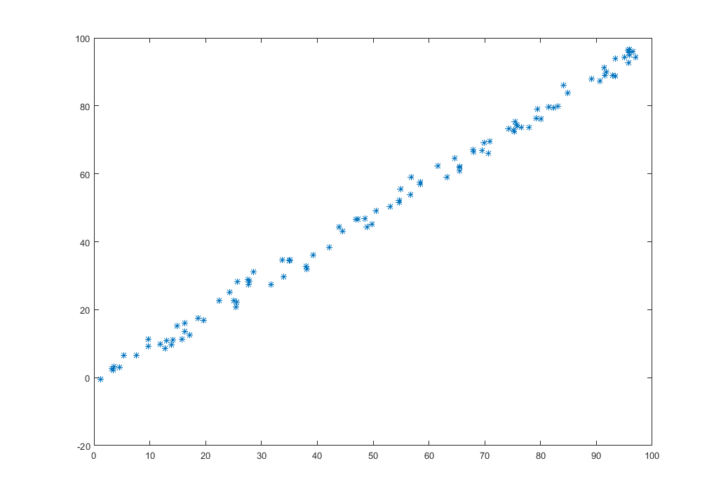
An Example For Machine Learning
Training Output：
y = x
New x: 18
Result: 18

Slide 10
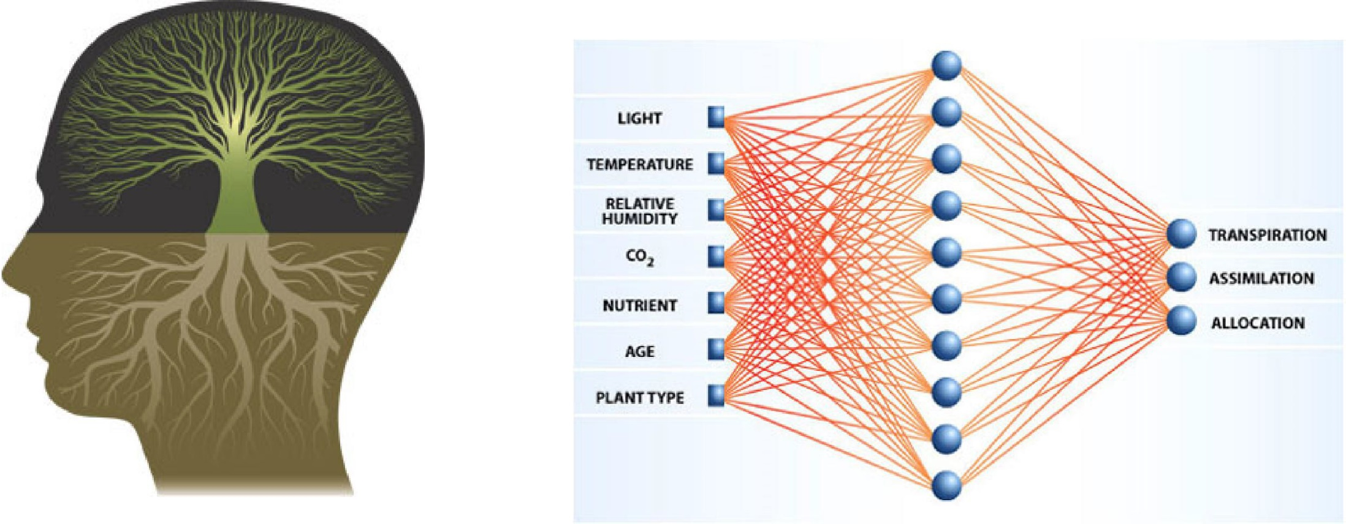
Neural Networks
Input layer
Hidden layer
Output layer

Slide 11
Deep Learning
output layer
hidden layer
Deep learning is a kind of neutral network with more hidden layers.
input layer

Slide 12
Why Go?

Slide 13
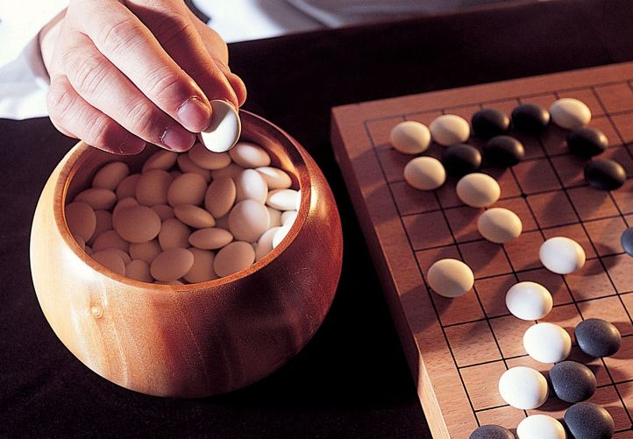
Go is difficult!
How human play Go?
Analyze global and local situation.
Find some feasible moves.
Predict a few more steps and choose the best move.

Slide 14
AlphaGo
Analyze global and local situation. (Position Evaluator)
X1
Board Status
Deep Learning
X2
Value Network
…
Winning Probability
Xn
Find some feasible moves. (Move Picker)
X1
Board Status
Deep Learning
X2
Policy Network
…
Feasible Moves
Xn

Slide 15
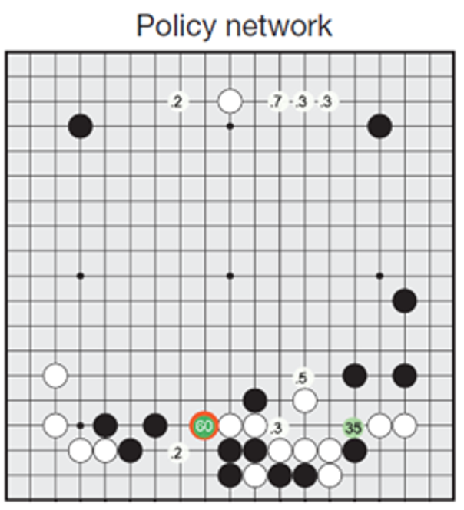
An example about how AlphaGo works
Use Policy Network to predict possible next move.

Slide 16
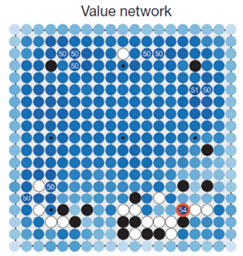
An example about how AlphaGo works
Simulation
Fight with itself. Using Value Network to judge the situation.
If win/loss possibility is high, count the result and start a new one.
Otherwise, keep fighting.

Slide 17
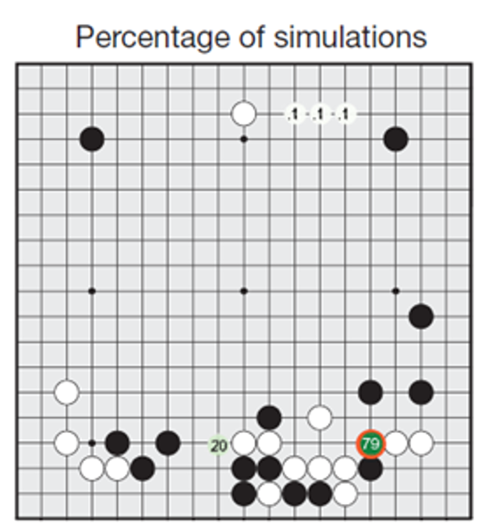
An example about how AlphaGo works
Choose the move with highest win possibility.

Slide 18
Why will AlphaGo dominate

Slide 19
Unbeatable features
Powerful computing ability
predict next move only takes 2 μs
Never tired
as long as there is electricity
Never make mistakes
guaranteed by program

Slide 20

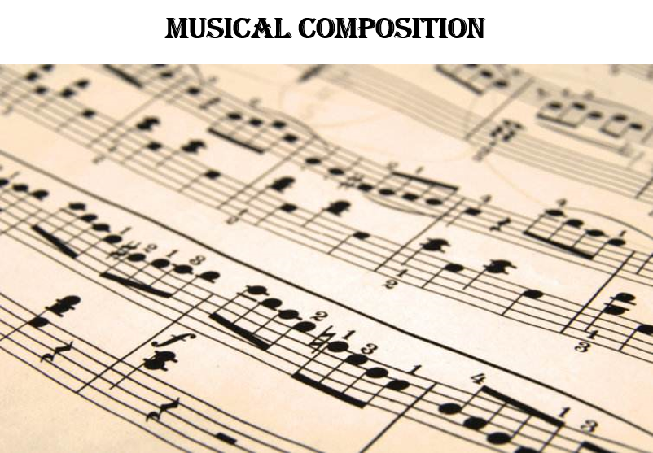
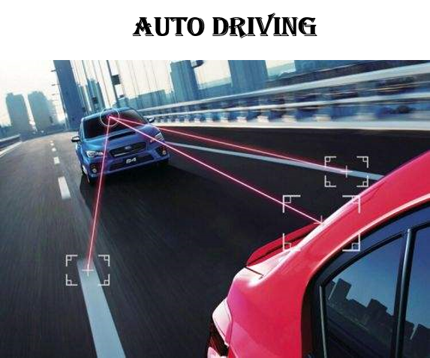

The Bright Future
What else can deep learning do?

Slide 21
Thanks！

